Slide 1

Analysing Successful Campaign Metrics

Slide 2

what is
•The world's largest funding platform for creative projects
•It facilitates direct support between creators and backers
•Success is defined by reaching (or exceeding) the funding goal

Slide 3
Problem Statment
Objective: To identify and quantify the key factors that predict a successful Kickstarter campaign.
Which categories offer the highest probability of success?
What funding and engagement metrics are crucial for achieving success?
Does the campaign's duration, launch month, or the target goal amount significantly impact the outcome?

Slide 4
Target Audince
Project Owners/ New Kickstarters
Potential Backers / Investors
Campaign Creators

Slide 5

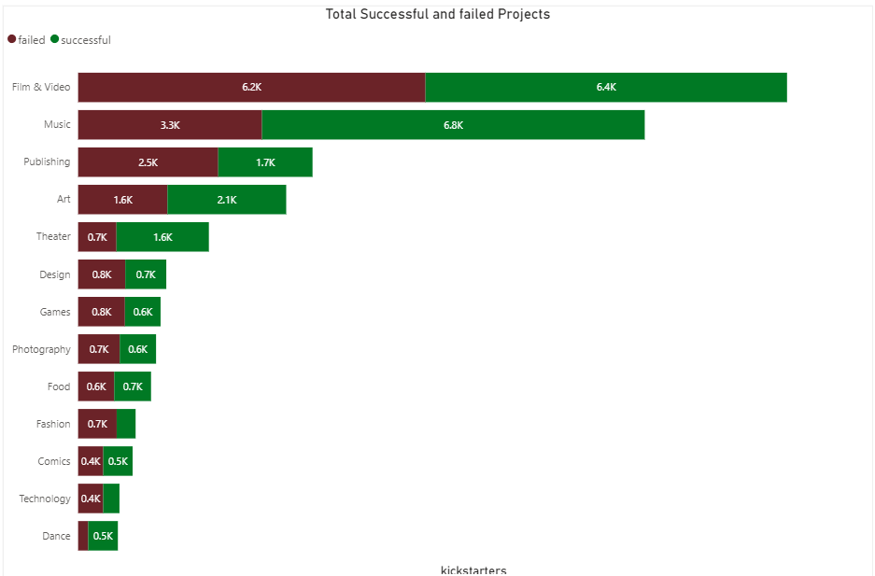

Slide 6
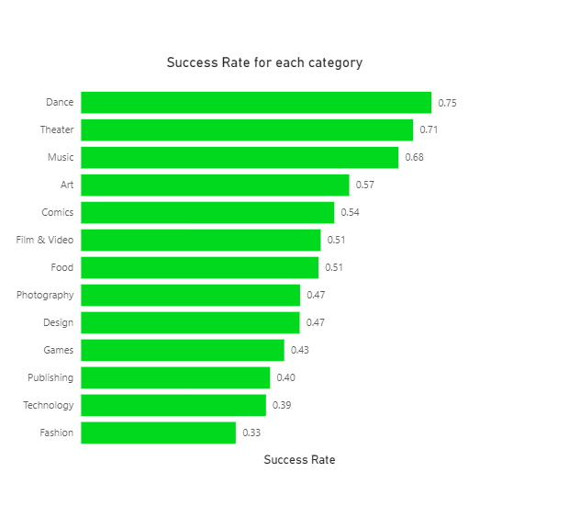

Slide 7
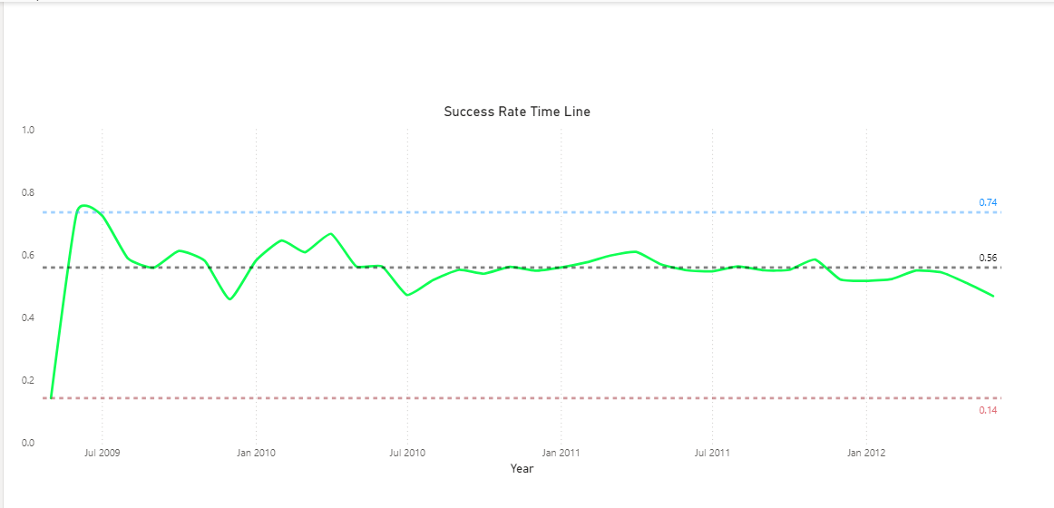

Slide 8
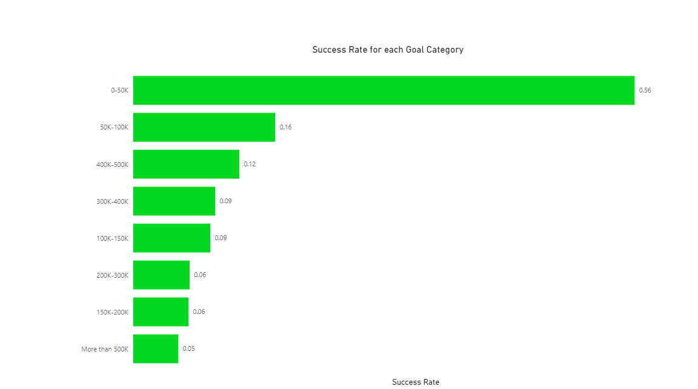

Slide 9
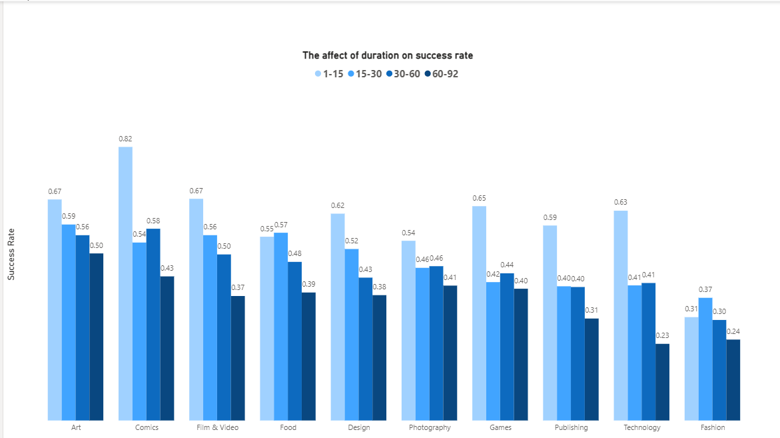

Slide 10
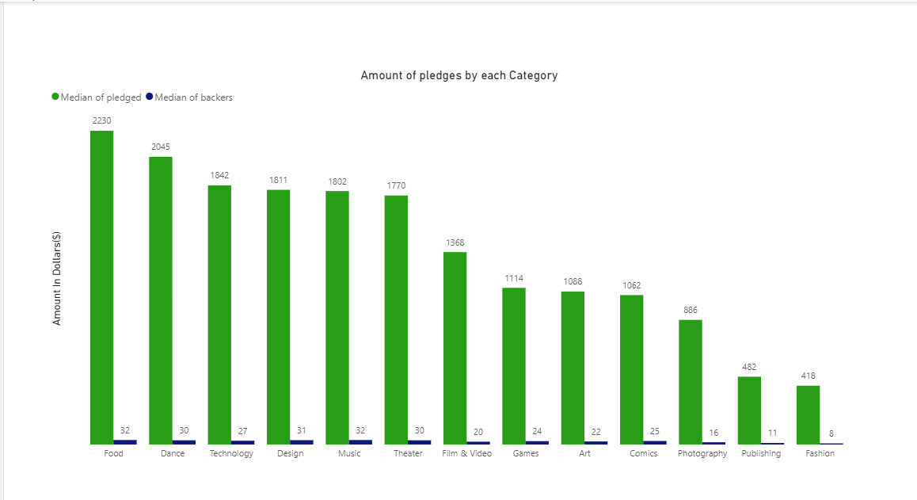

Slide 11
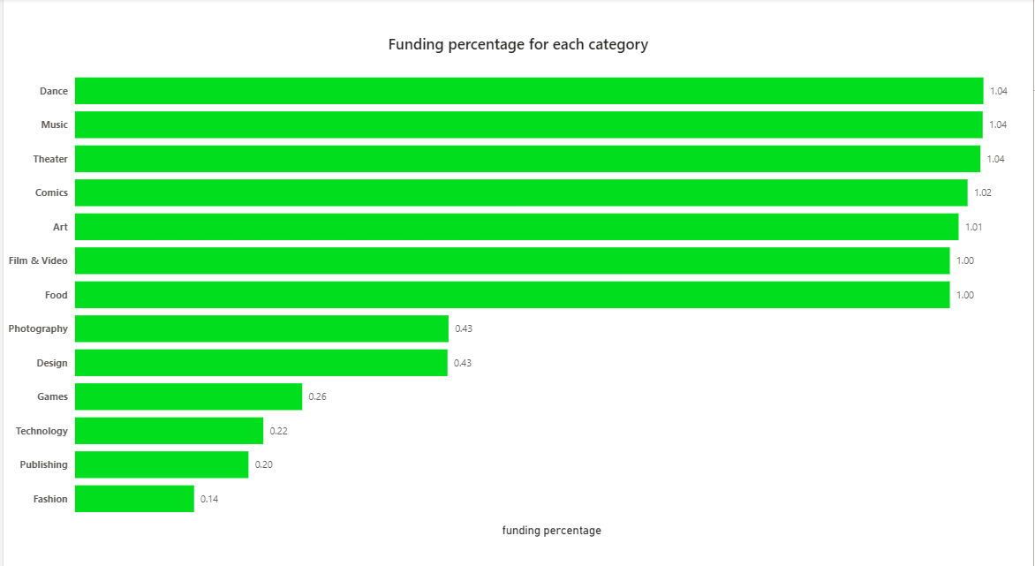

Slide 12
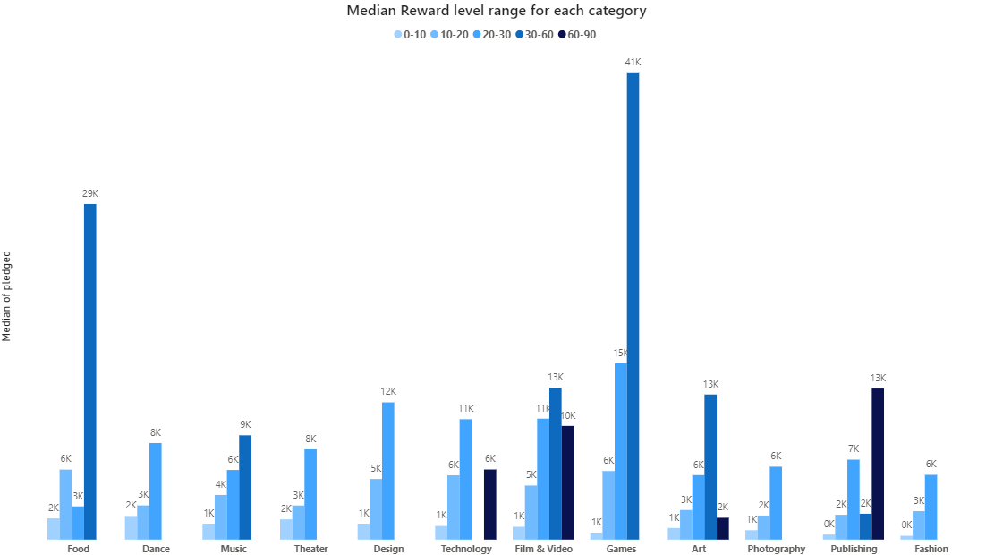
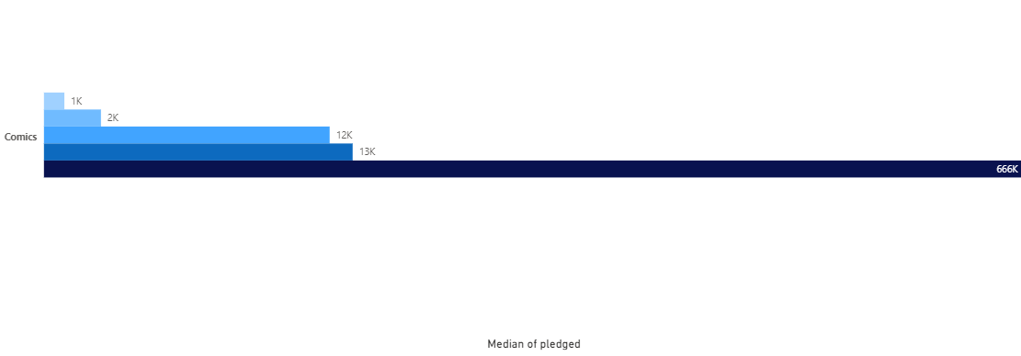
Investors/
campaign

Slide 13
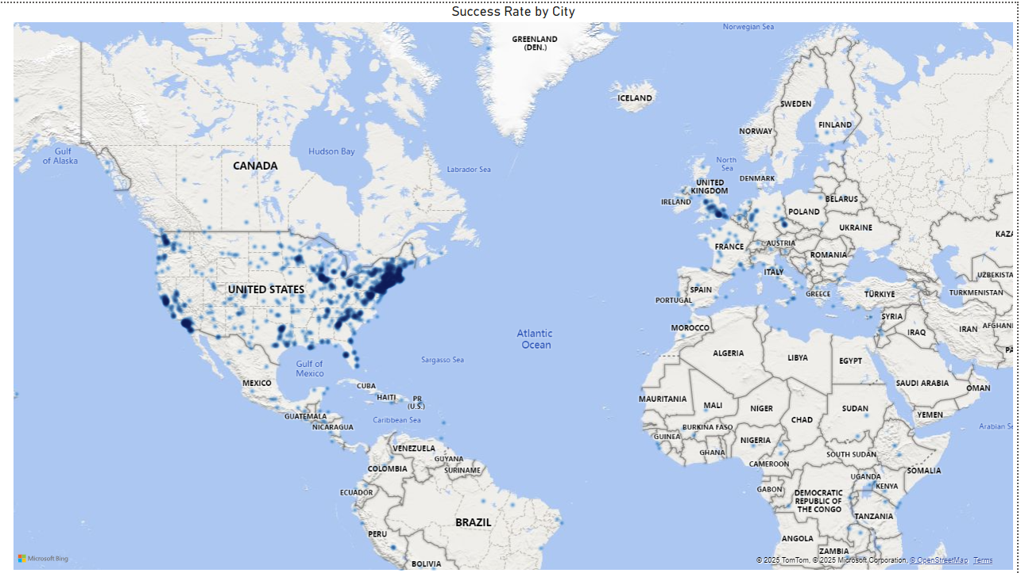
Investors/
campaign

Slide 14
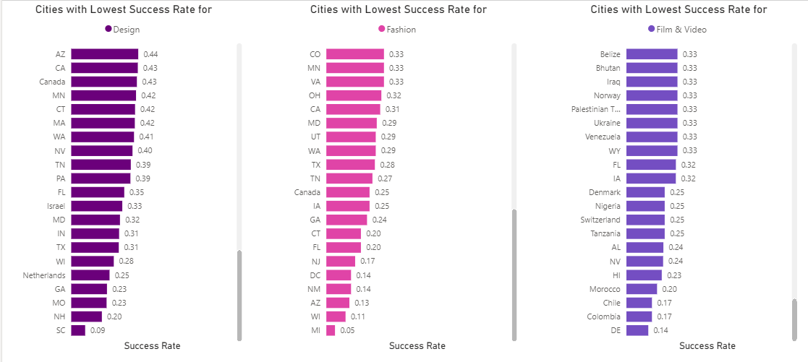
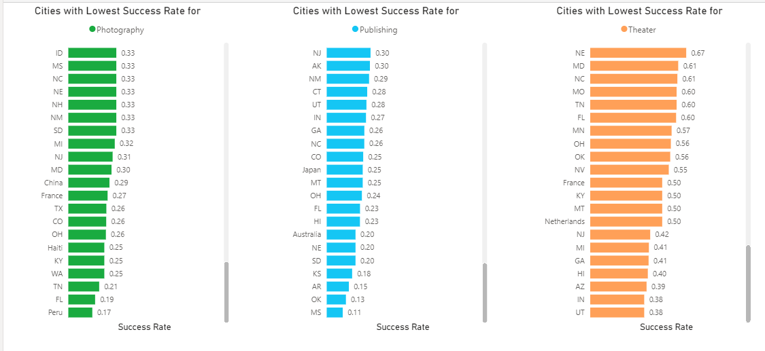
Countries
Countries
Countries
Investors/
campaign
Countries
Countries
Countries

Slide 15
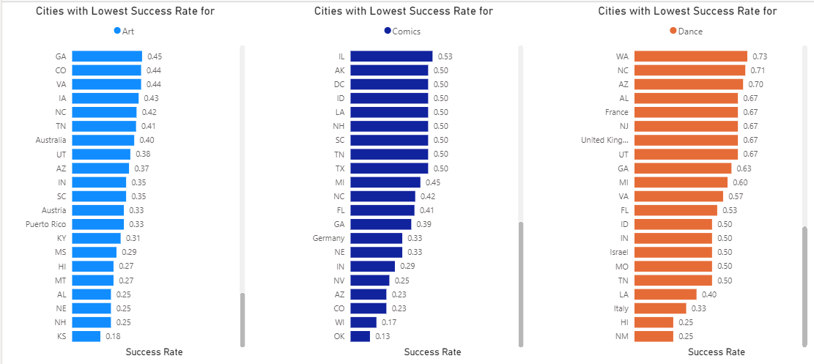
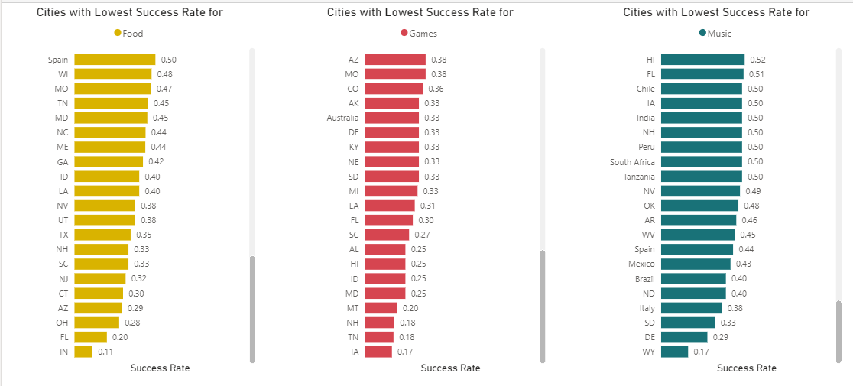
Countries
Countries
Countries
Investors/
campaign
Countries
Countries
Countries

Slide 16
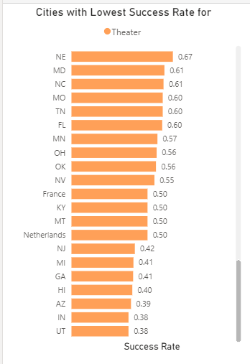
Investors/
campaign
Countries

Slide 17
Recomenddations
new kickstarters
Set a Modest Goal: Kickstarter creators must target a goal of $50K or less
Prioritise Short Campaigns:
Kickstarter should aim for a duration of
15 days or less
Optimize Category Choice: For the highest inherent probability of success, launch a project in the Dance, Theatre, or Music categories.
Select a proper Reward level:
selecting 20-30 levels

Slide 18
Recomenddations
Investors/campaign
Set a Modest Goal: Campaign creators must target a goal of $50K or less
Prioritise Short Campaigns:
Campaigns should aim for a duration of
15 days or less
Optimize Category Choice: Maximize success probability by choosing projects from performing categories in strategic locations
Select a proper Reward level:
Maximize success probability by choosing the preferred levels based on category

Slide 19

Thank you !

